Slide 1
HYBRID SOUTH ASIA LAUNCH EVENT
SEPTEMBER 16, 2025
Environment and Climate Change
Claudia Ringler and Muzna Alvi
Natural Resources & Resilience Unit

Slide 2
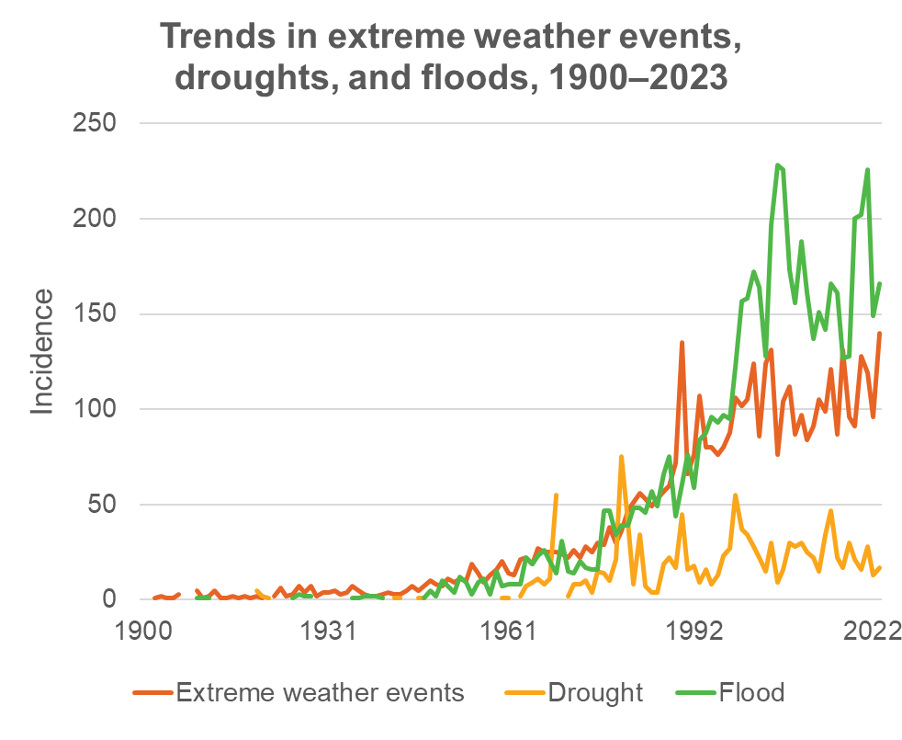
Externalities and sustainability of food production
Agriculture and the food system
consume >30% of energy
produce ~30% of GHG emissions
use >70% of withdrawn freshwater resources
main contributor to biodiversity loss
environmental and health hazards due to pesticide and excess chemical fertilizer applications
GFPR 2025, Chapter 5
Notes:
Assuming that the verbal presentation will say that “while agriculture produces many negative externalities, it is increasingly affected by extreme weather events (to connect the 2)

Slide 3
Clarifying the situation and outlook: Unequal impacts of climate shocks are concentrated in climate-agriculture-gender inequality hotspots
Darker orange countries show relatively high climate–agriculture–gender inequality hotspot index values -> higher risk, while lighter orange countries face lower risk. (LMICs with a white color have not been ranked due to data limitations)
Lecoutere et al. 2023
Notes:
Knowing which places are most at risk is important to prioritizing research and policy actions. Recent research identifies and quantifies climate, agriculture, and gender inequality hotspots, which are the regions where a high number of women in agriculture are exposed to and impacted by changes in climate and where they are particularly vulnerable to such changes due to a high level of gender inequality.
High risk areas are places where women are highly exposed and sensitive to climate hazards given their roles in agriculture and where they have less adaptive capacity due to gender inequalities
This figure presents results for the 87 LMICs
Darker red and dark orange colors indicate countries with relatively higher climate-agriculture and gender inequality hotspots while lighter orange and yellow colors highlight countries with relatively lower risk
This analysis was also done at sub-national level (for selected high risk countries)
This is a promising approach for improved targeting of interventions and resources because it takes into account socioeconomic data as well as the climate risks
This analysis can help prioritize policies, interventions, and investments to locations where climate risks are high, where women are more exposed and sensitive to these climate hazards, and where they lack the capacity to respond effectively to the climate hazards they experience

Slide 4
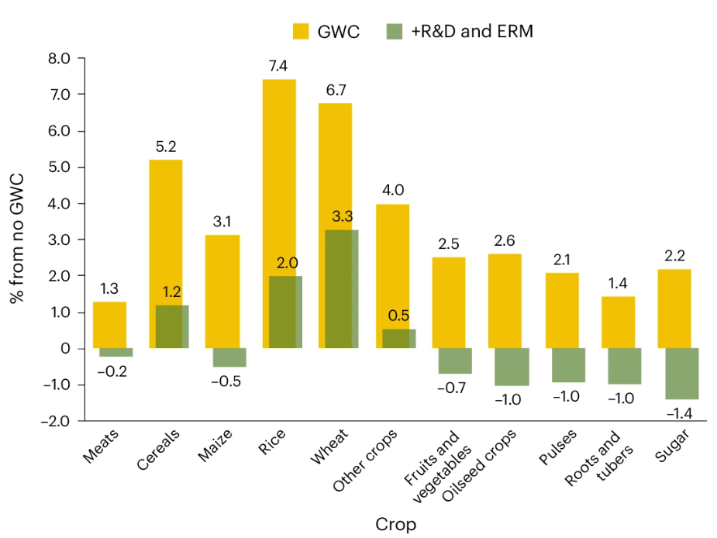
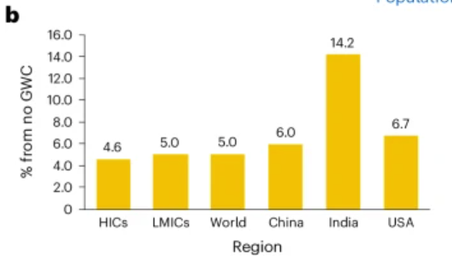
Clarifying the situation and outlook: Groundwater depletion worsens malnutrition long-term; but halting depletion without accompanying investments will also increase hunger and food insecurity
Increase in population at risk of hunger from halting GW depletion
Incentives/investments to reduce food security impacts are needed
Perez et al. 2024

Slide 5
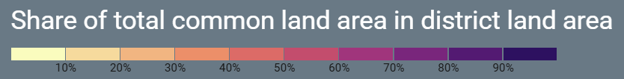
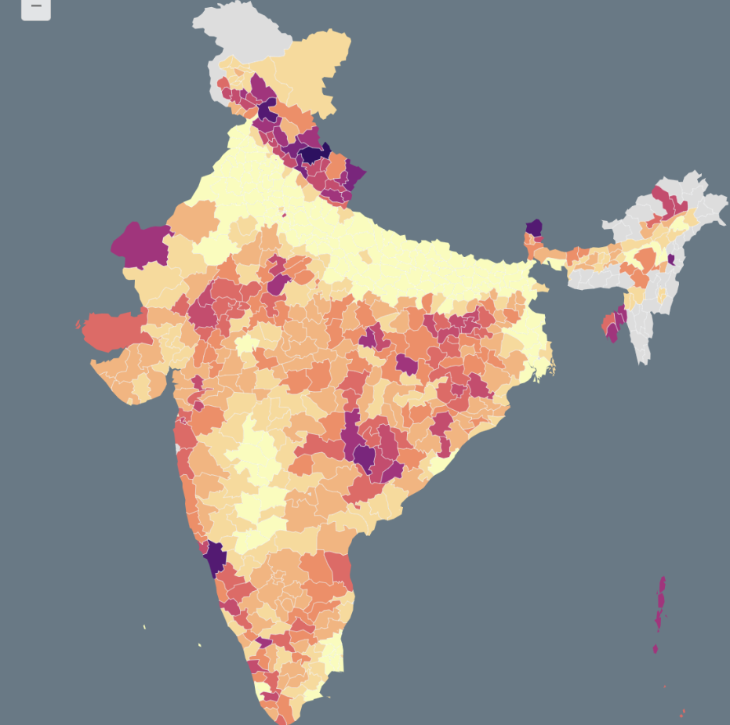
Testing, adapting and scaling solutions: Strengthen resource rights on common lands to retain ecosystem services
2.5 bn people depend on commons globally, 350 million people in India
Ecosystem services on common lands in India valued at ~ $90.5 billion
Highest value for forest commons at $2,108 ha/yr
Annual value loss: $750 million
Develop collective action mechanisms to strengthen rights on common lands
Sandhu et al. 2023

Slide 6
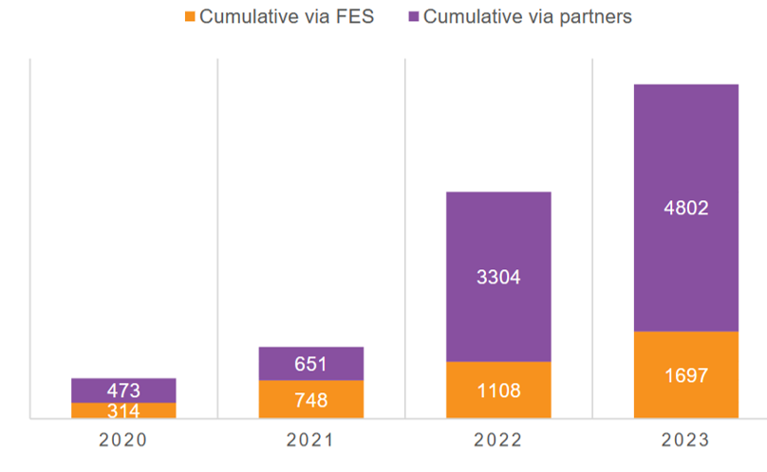
Testing, adapting and scaling solutions: Behavioral change interventions through experiential learning games to strengthen groundwater governance have reached scale
>8000 facilitators trained (mostly government/NGO)
Changes in local water by-laws and water use coordination mechanisms
Increases in investments in water infrastructure management
Reduction of irrigated area in post-rainy season
Strengthening of women’s participation in agricultural decision making
Sanil et al. 2025
Notes:
Is it trainers trained or facilitators trained?
Does this need to mention what the behavioral change interventions are? I added “experiential learning games”

Slide 7
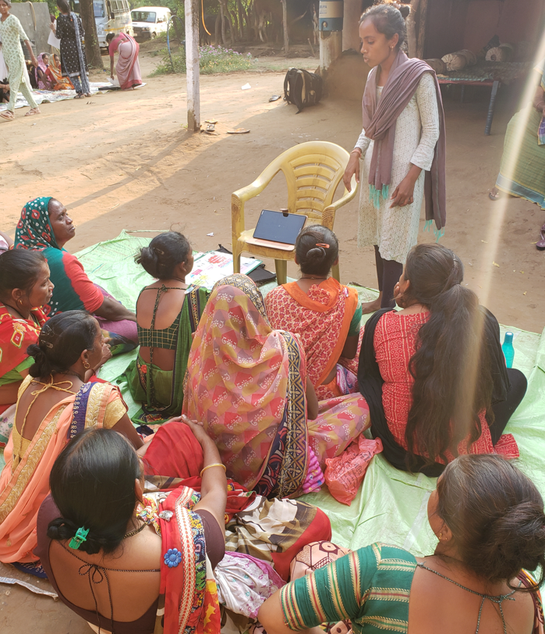
Strengthening capacity: Video-based extension of CSA targeted at women farmers overcomes women farmers' information gap
Increased adverse impacts of climate change are threatening agricultural production, food security and livelihoods
Lack of access to information a major constraint to adoption of CSA approaches, particularly for women farmers (Khoza et al. 2019; Bryan et al. 2021)
Participatory video-based extension can overcome information constraints
Study in India: Videos increased awareness and adoption of CSA practices (soil testing, IPM) by women farmers in Gujarat, India
Notes:
May need to explain CSA

Slide 8
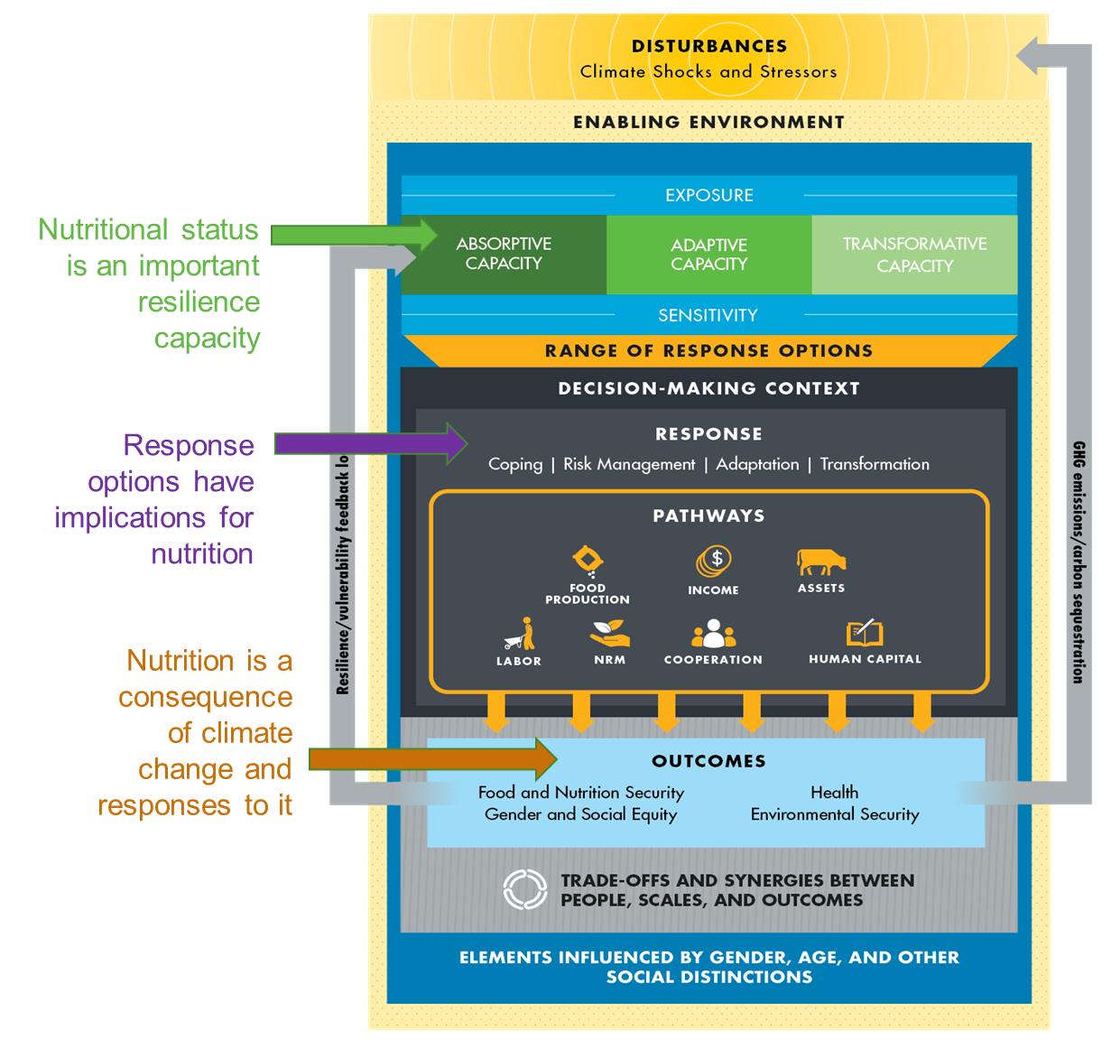
Shaping enabling environment: Gender, climate and nutrition (GCAN)
Demand driven research agenda focusing on intersections between gender, climate, and nutrition
Working with partners and policy makers-->Gender Resilience Cell
Synthesis products:
  Review on the risks of climate change for nutrition, diets and food systems (Fanzo, et al. 2018)
  Review on gender, resilience and food systems (Bryan, Ringler, and Meinzen-Dick 2023)
  Review on gender and climate change (Bryan, Alvi, Huyer, and Ringler 2024)

Slide 9

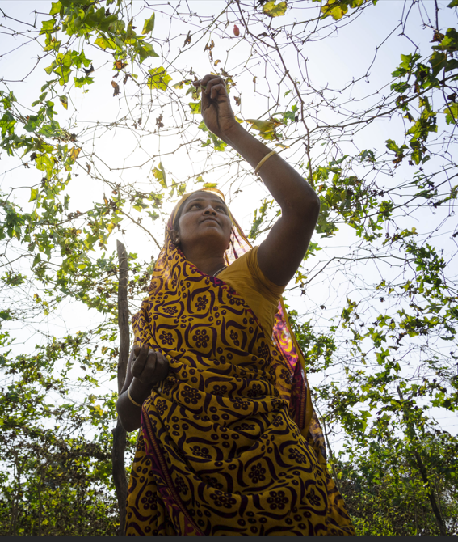
Future directions
“Quantifying” opportunities for resource conservation and cost effectiveness of interventions
Innovative climate finance and insurance products for smallholders
Putting farmers in the driver’s seat through AI-enabled technologies for better resource management
Strengthening community collective action to achieve larger and lasting transformations
Identifying climate-resilient water and energy solutions for improved food security
Supporting policies and institutions that improve the natural resource base while improving food security
Notes:
It’s covered in “institutions” but a lot of what is needed relates to collective action. The overall thrust of this, especially with the final point on AI, seems to go back to the government and individual farmers, but a lot of what we draw attention to is the need for intermediate level institutions. I added a bullet #3 to that effect, but you can modify

