Slide 1
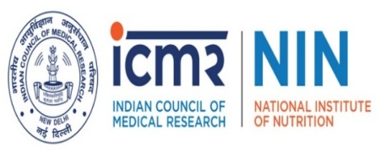
National Symposium on Makhana Evaluation of Value-Added Products and Health Benefits from Makhana
Dr Mahesh Kumar Mummadi
MBBS., MD., FCD.,FCGP
Medical Scientist, Clinical Epidemiology Division,
ICMR-National Institute of Nutrition, Hyderabad

Slide 2
Malnutrition in India in Millions
CNNS Report 2019
Notes:
4.6 Crores of Stunting, 7.2 crores of Diabetics .... 16.6 crores of Overweight and Adults ..and Astonishing 44.7 crores of Anaemia in All Ages

Slide 3
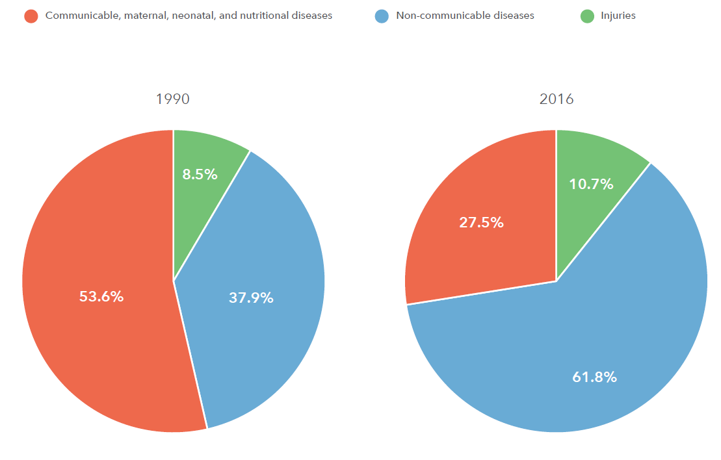
Contribution of major deaths in India
The India State Level Disease burden Initiative report 2017

Slide 4
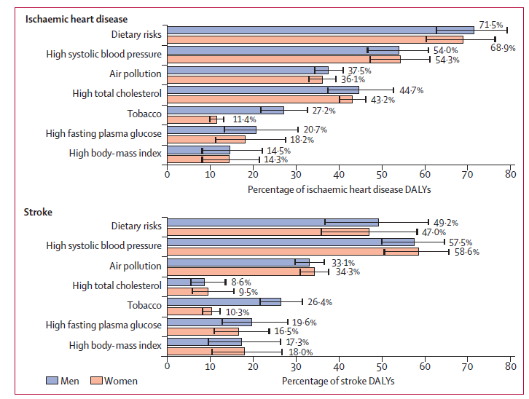
Percentage contribution of major risk factors of IHD and stroke
The India State Level Disease burden Initiative report 2017
Notes:
Previously it used to be only HTN.. Now Dietary Risk factors are one of the Top factors for NCDs

Slide 5
Introduction
Makhana (Euryale ferox Salisb) also known as gorgon nut, is an important aquatic crop belonging to the family Nympheaceae.
It is normally grown in stagnant water bodies like low depressions, ponds, lakes etc.
This plant is considered as a native of South-East Asia and China and its distribution is extremely limited to tropical and sub tropical regions of South-East and East Asia.
In India, it is grown in West Bengal, Bihar, Manipur, Tripura, Assam, Jammu and Kashmir, Eastern Odisha, Madhya Pradesh, Rajasthan and Uttar Pradesh.
However, 90% of the world production of Makhana takes place in Bihar state itself.
It is considered as nutrient rich products although scattered and limited reports are available on nutritional composition of makhana.
literature suggests that Makhana contains good amount of carbohydrates, protein and micronutrients.

Slide 6
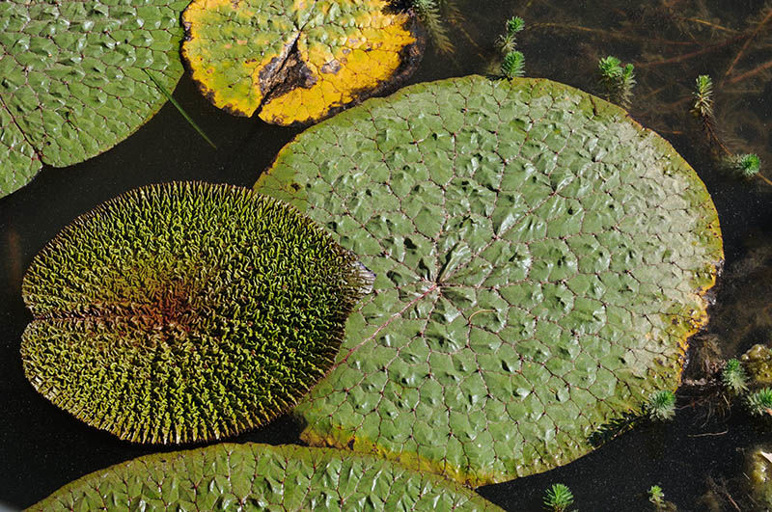
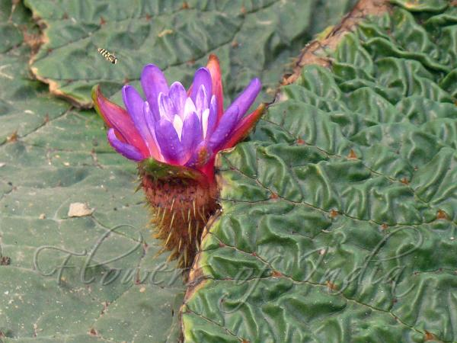
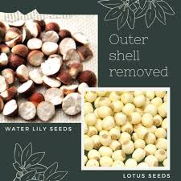

Slide 7
Nutritional Composition-Popped Makhana
Available Carbohydrates: 78%
Proteins: 10%
Total Dietary Fiber: 3 %
Minerals: Rich in Phosphorus, Potassium, Calcium, Magnesium
Antioxidant Activity: 12% DPPH inhibition
Rich in amino acids (including essential amino acids)
Omega 6:3 ratio is upto 40.
Popping makhana improves its dietary fiber content, notably insoluble fiber, enhances B-vitamins, minerals (Fe, Zn, Cu), and antioxidants (polyphenols and α-tocopherol).
It significantly increases free sugars, digestible starch, and making it energy-rich and easier to digest.
Additionally, the fatty acid profile shifts positively, increasing beneficial unsaturated fats.
Overall, popped makhana offers better nutritional value and enhanced antioxidant potential compared to raw makhana.

Slide 8
Proximate analysis
Enhanced Mineral Bioavailability Phytic acid improves absorption of calcium, magnesium and trace elements.
Micronutrients (Fe, Zn, Cu) remain good, and recent Element analysis shows high Phosphorous. popped makhana still delivers key cofactors for osteoblast function and collagen cross-linking.
Protein remains ~9 g/100 g after popping, with essential amino acids (methionine, arginine, cystine) intact to fuel collagen matrix synthesis.
Mahesh Kumar, M., Goudar, G., Sharma, P. et al. Differentiating the nutrient composition, in-vitro starch digestibility, individual polyphenols and anti-oxidant properties of raw and popped makhana (Euryale ferox). Food Measure 17, 5828–5844 (2023). https://doi.org/10.1007/s11694-023-02074-5

Slide 9
Prebiotic Fiber & Resistant Starch Soluble Fiber and resistant starch support gut microbiota production of short-chain fatty acids (e.g. butyrate), which have been linked to enhanced calcium absorption and bone formation.
Mahesh Kumar, M., Goudar, G., Sharma, P. et al. Differentiating the nutrient composition, in-vitro starch digestibility, individual polyphenols and anti-oxidant properties of raw and popped makhana (Euryale ferox). Food Measure 17, 5828–5844 (2023). https://doi.org/10.1007/s11694-023-02074-5

Slide 10
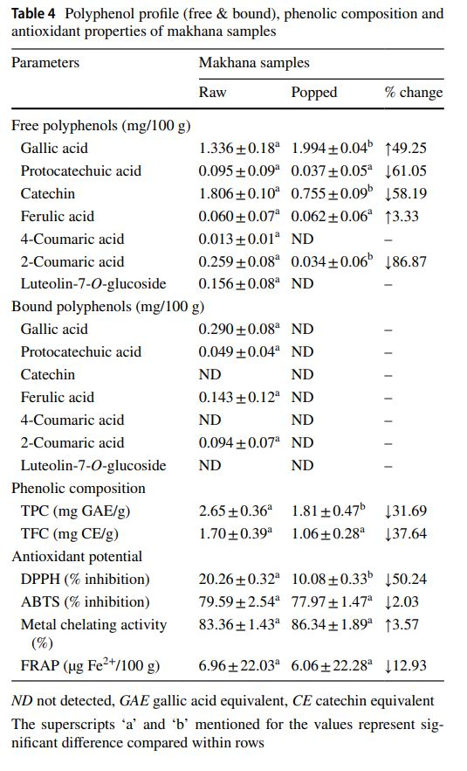
Greater Antioxidant & Anti-inflammatory Potential Free polyphenols (e.g. gallic acid, catechin, protocatechuic acid) bolster scavenging of reactive oxygen species that drive osteoclast activation.
Total phenolic content and metal-chelating activity stay high, helping to dampen chronic inflammation (TNF-α, IL-6) which otherwise accelerates bone resorption.
Favorable Fatty Acid Profile PUFAs (especially linoleic acid) and total ω-6/ω-3 ratio shifts toward anti-inflammatory balance, mitigating inflammatory bone loss.
Mahesh Kumar, M., Goudar, G., Sharma, P. et al. Differentiating the nutrient composition, in-vitro starch digestibility, individual polyphenols and anti-oxidant properties of raw and popped makhana (Euryale ferox). Food Measure 17, 5828–5844 (2023). https://doi.org/10.1007/s11694-023-02074-5

Slide 11
Popular Value-Added Makhana Products
1. Flavored Roasted Makhana
These are puffed and seasoned Makhana snacks available in diverse flavors such as tomato, pudina (mint), chili, butter, and more. They cater to health-conscious consumers seeking low-calorie snack options.
2. Makhana Flour
Produced by grinding unpopped Makhana seeds, this gluten-free flour is used in baking and as a thickening agent in various dishes.
3. Makhana Kheer Mix
A ready-to-cook dessert mix combining Makhana with ingredients like milk powder and sugar, simplifying the preparation of traditional kheer.
4. Makhana Bhujia and Namkeen
These are savory snacks where Makhana is mixed with fried lentils, nuts, and spices, offering a crunchy and flavorful treat.
5. Makhana-Based Sweets
Traditional Indian sweets like laddoos and barfis are crafted using Makhana, often combined with ingredients like jaggery, nuts, and ghee.
6. Makhana Energy Bars
Combining Makhana with dry fruits, seeds, and natural sweeteners, these bars serve as nutritious on-the-go snacks.
7. Makhana in Breakfast Cereals
Brands incorporate Makhana into breakfast cereals and muesli, enhancing their nutritional profile and offering a crunchy texture.
8. Makhana-Based Savory Dishes
Innovative recipes like masala Makhana mathri and mixed vegetable Makhana cutlets are being developed, blending traditional flavors with modern culinary techniques.

Slide 12
Medicinal properties:
Makhana also reported to have several medicinal properties. It is mentioned in Ayurveda and Chinese traditional medicine.
A study by Ahmed et al shows Antidiabetic, antioxidant, antihyperlipidemic effects of Makhana seeds on Diabetic mice. The study shows the effect is due to the presence of 2β-hydroxybetulinic acid 3β-oleiate (HBAO), a novel compound isolated from the seeds of Euryale ferox salisb.
A study by Tunyu jain et al shows seed coat of Makhana has Hepatoprotective effect in NAFLD induced by High fat Diet in Mice by Increasing IRs-1 and Inhibiting CYP2E1
A study by Wen-Na Zhang et al shows that a polysaccharide fraction (EFSP-1) Glucan was obtained from the seeds of Makhana which has shown in vitro hypoglycemic activity.
Value added products: Popped Makhana, Flavoured makhana and Makhana Kheer Mix

Slide 13
Need for Clinical Studies:
As per the available literature the studies are limited to preclinical evaluation of makhana
In view of its medicinal uses based on the studies conducted in animal models and invitro studies, there is a need to address the gaps by studying in Clinical settings which gives highest level of evidence.
One such attempt is RCT -Diabetes

Slide 14
Randomised control trial
Study Setting :
Diabetic individuals living in Urban Slum, Hyderabad
Sample size:
30 Diabetic adults – Makhana Group (Intervention arm)
30 Diabetic adults – Control Group
Inclusion criteria:
Diabetic <5yr diagnosis
Age 20-60 years
HbA1C </8.5
Oral antidiabetic drugs <2 no’s
Exclusion criteria:
Complicated diabetic individuals
Pregnant/ Lactating woman
Individuals unwilling to take part in the study
Notes:
Slide no.- 23

Slide 15
Study Design
Diabetic Adults
Intervention Arm with Makhana
30 Diabetic Adults
One Meal Replacement with Makhana for 3 months
Endline Investigations
Baseline Investigations
Control Arm
30 Diabetic Adults
Baseline Investigations
No Meal replacement for 3 months
Endline Investigations
Screening of Subjects for Identification of
Type 2 Diabetes by HbA1C test (n= 365)
Exclusion of Individuals who doesn’t fit inclusion criteria (n=273)

Slide 16
Food Supply and Safety:
Makhana is provided by CIPHET, ICAR. Proper hygienic packing and labelling information (like storage conditions and usage period) are ensured
Data Collection:
A structured questionnaire (Adapted from WHO STEPS) administered at baseline and endline along with assessment of Anthropometric, sociodemographic, clinical and biochemical parameters (CBP, HbA1C, Hb, Fasting Insulin, C-peptide, HOMA-IR, HsCRP, Liver function tests, Thyroid function tests, Lipid profile, Kidney function tests), 24-hr dietary recall through weighment method, assessment of physical activity.
Compliance, morbidity history with home visits are done.

Slide 17
Household Demographic data
Preliminary data, Socio-economic status
Anthropometry
Height
Biomarkers
FBS & PLBS
Dietary data
24 hr Diet recall through weighment method
Adapted from STEPS questionnaire and pre tested
Weight
Hip circumference
Waist circumference
Fasting insulin
C peptide
HOMA -IR
HsCRP
LFT, RFT
Serum Creatinine
Vitamin B12 & D
Homocysteine
CBP
Lipid profile
HbA1C

Slide 18
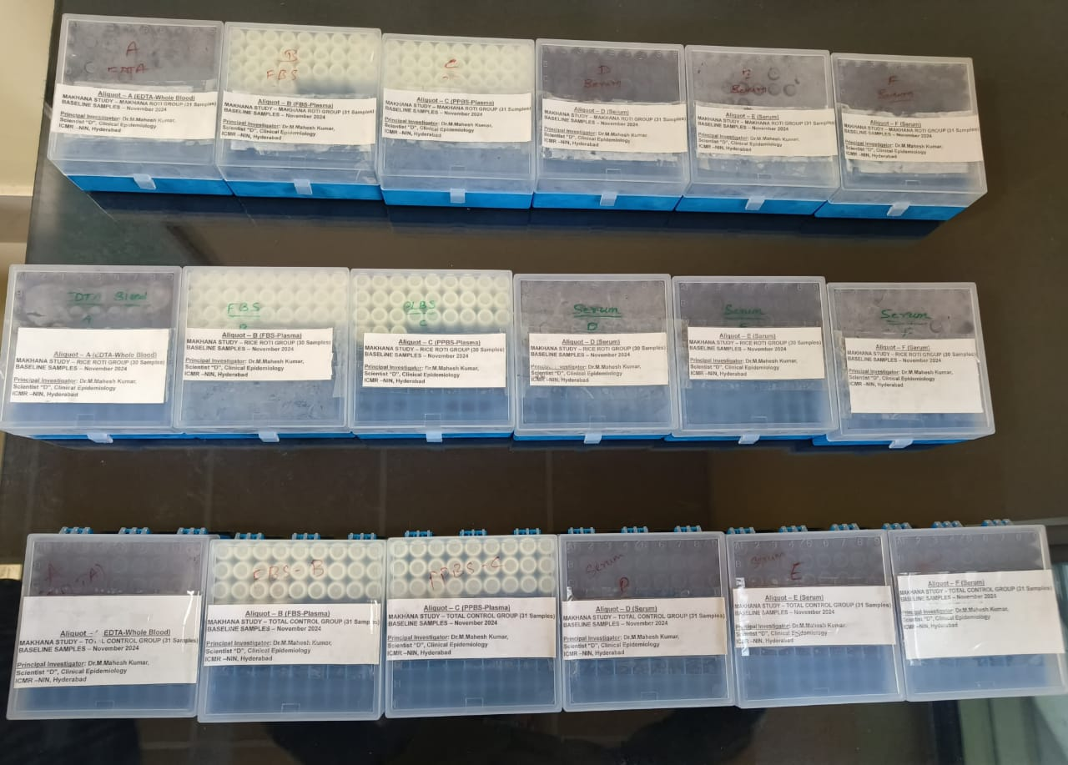
Analysis of Blood sample collection and sample coding

Slide 19
Randomization:
Groups Matching with Age, BMI, HbA1C, Fasting and Post Lunch
Baseline characteristics

Slide 20
Workshop with Participants before start of the Intervention

Slide 21
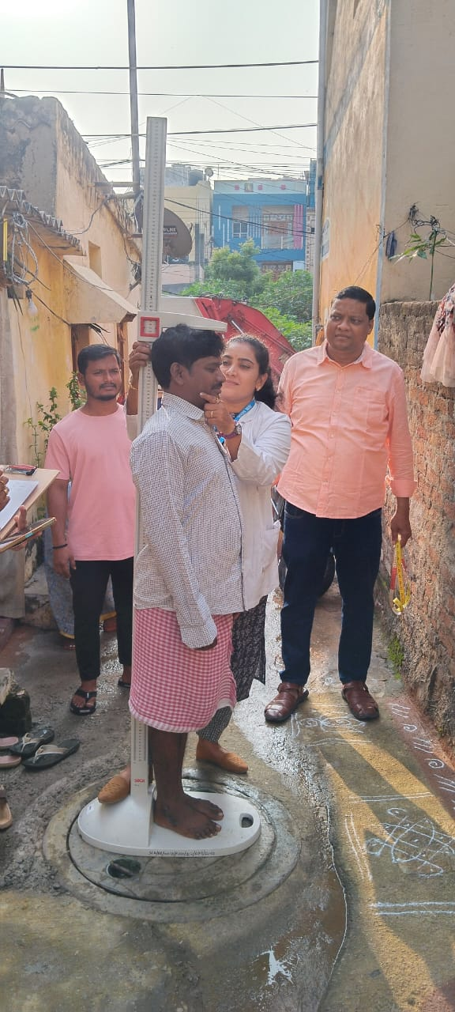
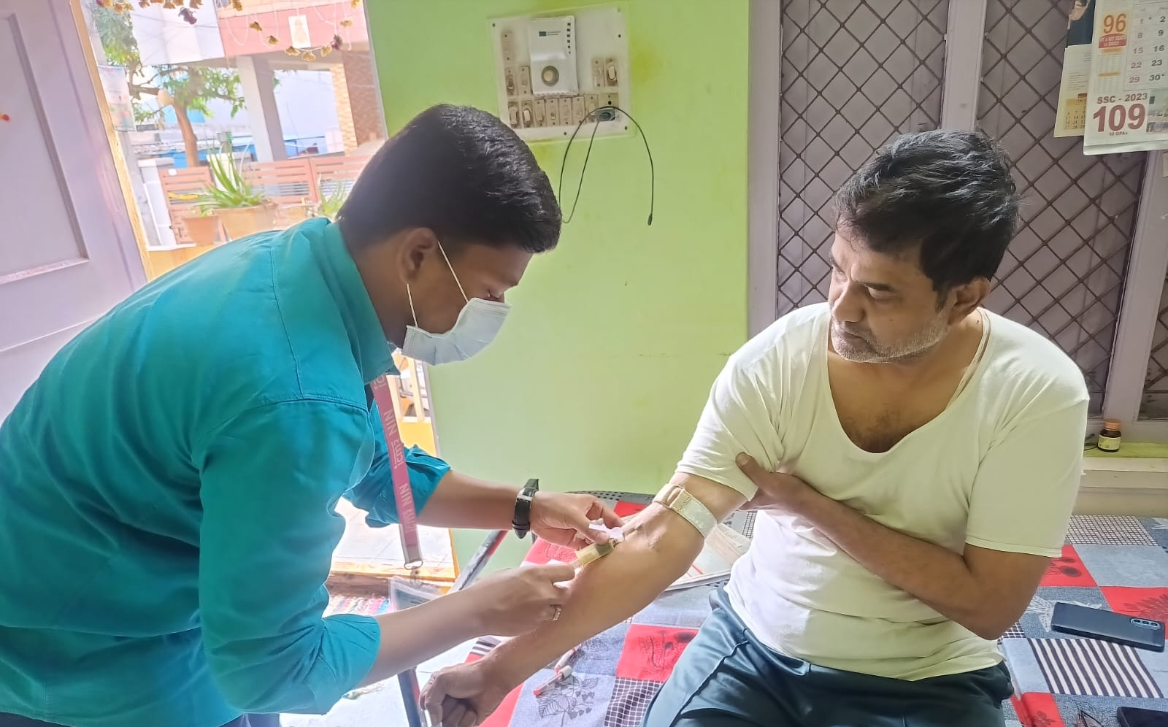
Anthropometry and Screening Blood sample collection

Slide 22
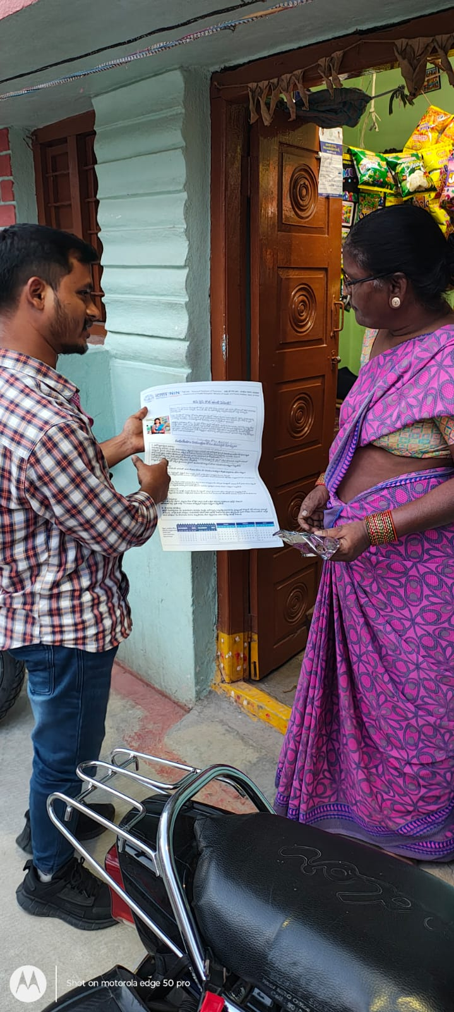
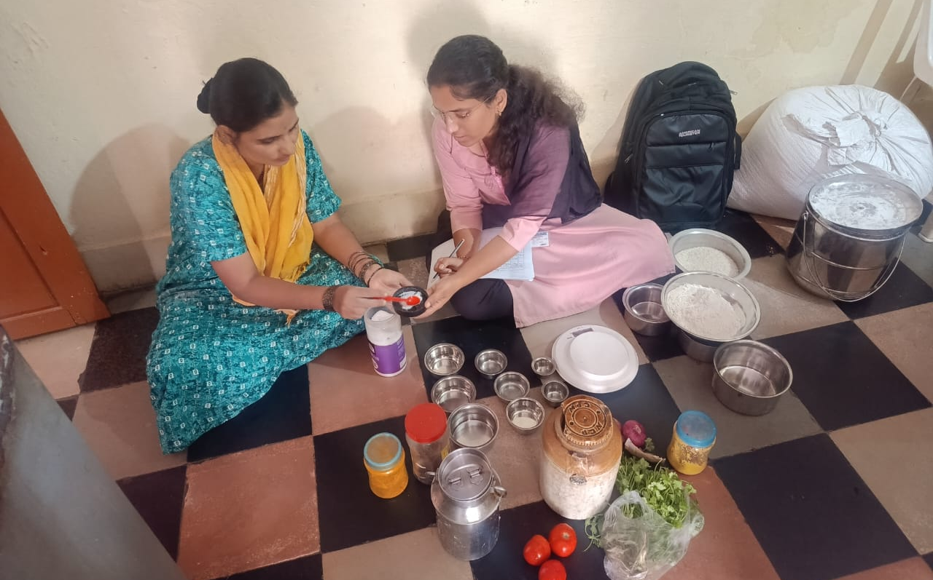
Diet history and Distribution of IEC Material to the participants

Slide 23
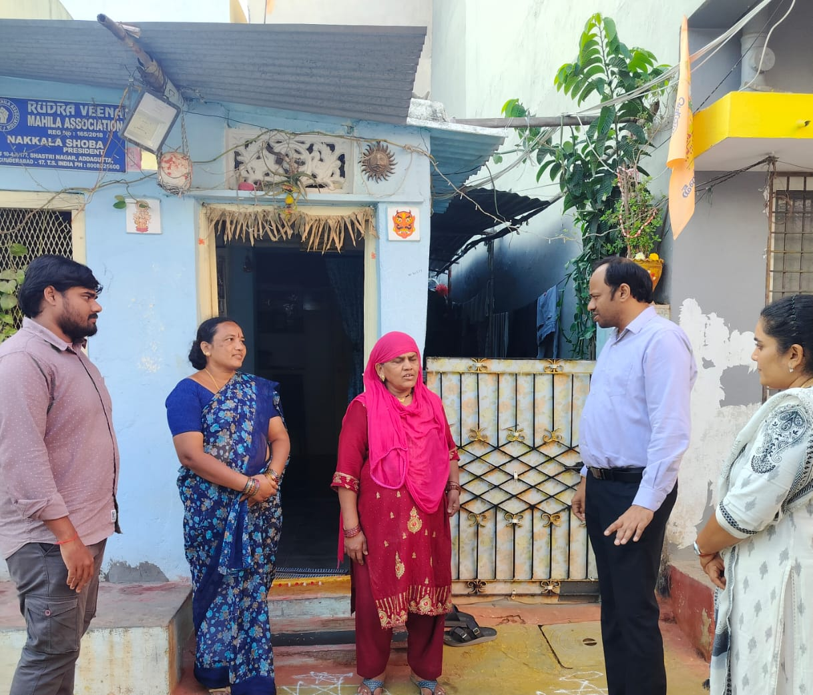
Interaction with study participants

Slide 24
Mean Change in Fasting, Post Prandial and HbA1C between Groups:

Slide 25
RCT Key Results
There is a significant beneficial changes with Makhana consumption compared to the control group across glycemic parameters: fasting blood sugar (FBS), post-lunch blood sugar (PLBS), and HbA1c levels.
Specifically, the Makhana group demonstrated a notable reduction in mean fasting blood sugar (~25 units), a substantial decline in post-lunch blood sugar (~40 units), and a moderate yet clinically relevant decrease in HbA1c (~0.2 units), while the control group showed minimal or opposite changes.
Thus, these results strongly suggest that Makhana effectively improves glycemic control.
A reduction in HOMA-IR (by 0.5) indicates enhanced insulin sensitivity, meaning the body is utilizing insulin more effectively, reducing insulin resistance.
Concurrently, a significant decrease in C-peptide (by 0.6 ng/mL) suggests that the pancreas does not need to produce as much insulin, indicating decreased pancreatic stress and improved beta-cell function.
Together, these findings highlight that Makhana consumption may effectively support better metabolic control, potentially preventing or delaying progression towards diabetes and related metabolic disorders.

Slide 26
Conclusions & Recommendations:
Makhana supplementation gave good improvements in fasting and post-prandial blood sugars and significant HbA1c reduction.
Additional benefits: β-cell preservation , improved insulin sensitivity.
Hence, Makhana, can be an adjuvant in Diabetes along with medicines, where delay in insulin resistance can prevent the complications.
Recommended for early-intervention and diet-focused strategies.

Slide 27
Future Clinical Studies : Way Forward:
Effect on long term diabetes,
Effect on Gut/Digestive system health
Effect on Musculoskeletal system- currently ongoing
Effect on cardiovascular health,
Effect in maternal and child nutrition,
Effect in sports nutrition, and
Effect of fortified functional food.
These studies will strengthen evidence-based claims, enhancing Makhana's therapeutic potential and market value.

Slide 28
Complete Diet Model plate-ICMR-NIN
All Nutritional problems , Undernutrition, overnutrition and Hidden hunger can be Prevented by Taking Ideal quantities of food to take daily .
No Supplements will provide the adequacy of all nutrients. Hence the Complete Diet Model plate with daily consumption of all food groups have been prepared by ICMR-NIN
Micronutrients from food are better absorbed and more bioavailable than supplements.
It helps in improving Immunity and Resistance to Infections, maintain Good microbial flora, prevent NCDs, Reduce Inflammation, prevents adverse effects of Environmental pollution and toxins and works as detoxifying Diet

Slide 29
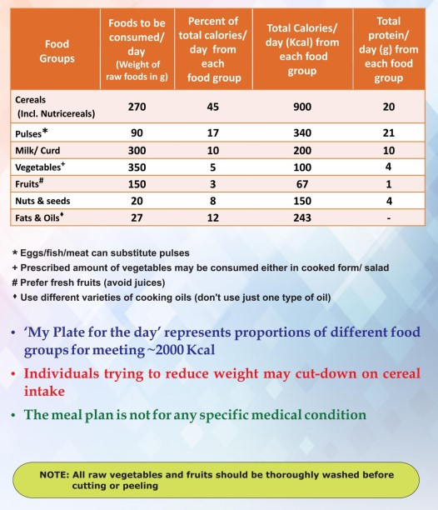

Slide 30
THANK YOU
400 B.C. -- Hippocrates, the "Father of Medicine", said to his students, "Let thy food be thy medicine and thy medicine be thy food".
It can be loosely translated into
“we should eat food as medicine otherwise we have to eat medicine as food”

Slide 31
THANK YOU

Slide 32
Glycemic Index (GI) – Glycemic Index (GI) is a indexing of carbohydrate containing foods according to their effect on blood glucose levels. Carbohydrate foods that are digested quickly and rapidly release glucose into the blood stream have a high GI; those that are digested slowly or partially and gradually release glucose into the blood stream have a low GI.
Glycemic Response – Glycemic response generally refers to the changes in blood glucose after consuming a carbohydrate-containing food.
Glycemic Load (GL) – Glycemic load is a measure of the degree of glycemic response and insulin demand elicited by a given amount of a certain food. Glycemic load reflects both quality and quantity of dietary carbohydrates.

Slide 33
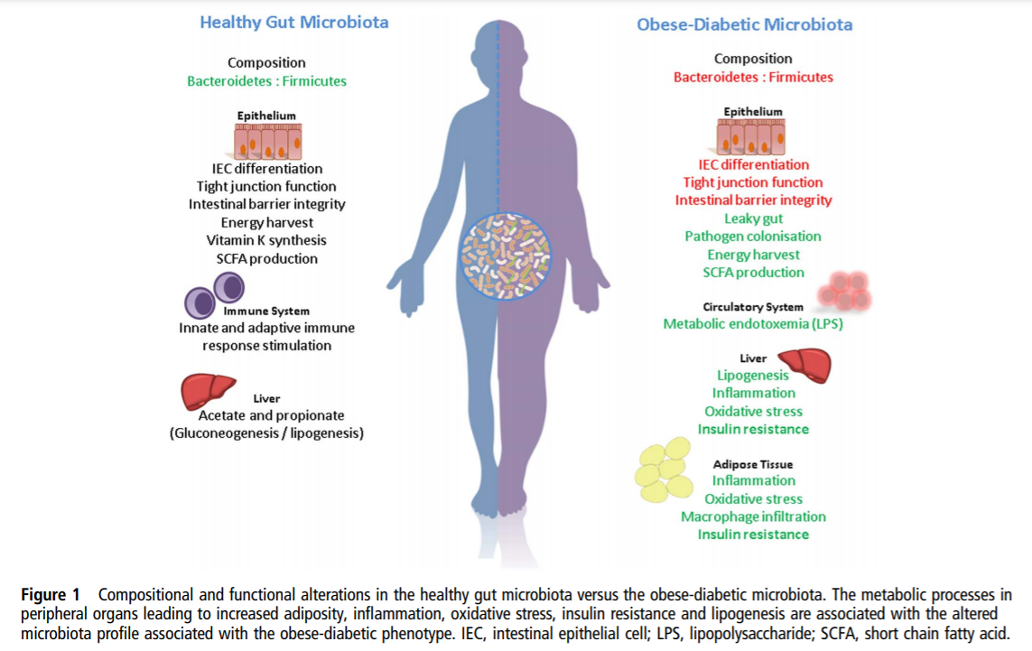
Gut Microbiome and Diabetes- we are what we eat ? Or We are what our Microbes eat ??
As per The Consensus Report Diabetes Care 2019 Studies using personalized nutrition approaches to examine genetic, metabolomic, and microbiome variations have not yet identified specific factors that consistently improve outcomes in type 1 diabetes, type 2 diabetes, or prediabetes.
Patterson E, et al. Postgrad Med J 2016;0:1–15. doi:10.1136/postgradmedj-2015-133285

Slide 34
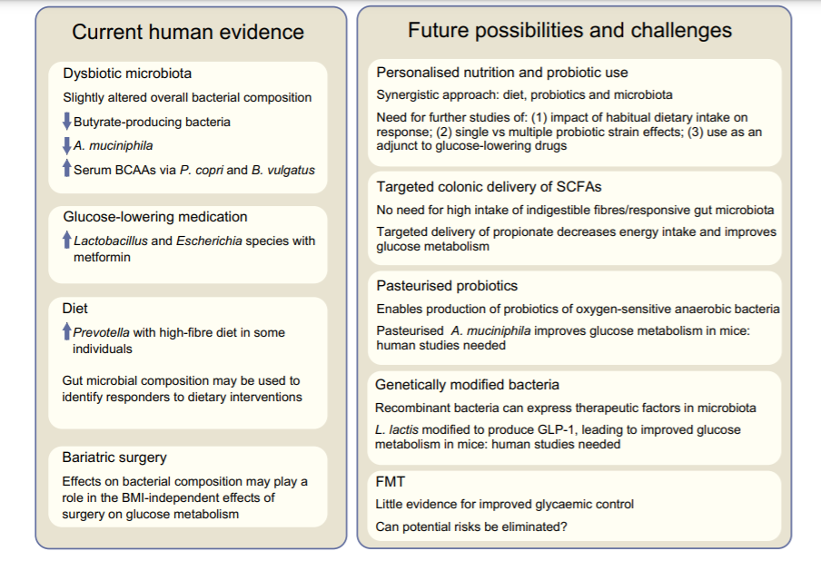
Gut Microbiome and Diabetes- we are what we eat ? Or We are what our Microbes eat ??
Louise Brunkwall & Marju Orho-Melander ,
Diabetologia DOI 10.1007/s00125-017-4278-3

